Slide 1


Matthew Winder
January 2022

Slide 2

Outline
Executive Summary
Introduction
Methodology
Results
Conclusion
Appendix

Slide 3
Executive Summary
Summary of methodologies
Summary of all results

Slide 4
Introduction
Project background and context
Problems you want to find answers

Slide 5


Slide 6
Methodology
Executive Summary
Data collection methodology:
Describe how data was collected
Perform data wrangling
Describe how data was processed
Perform exploratory data analysis (EDA) using visualization and SQL
Perform interactive visual analytics using Folium and Plotly Dash
Perform predictive analysis using classification models
How to build, tune, evaluate classification models

Slide 7
Data Collection
Describe how data sets were collected.
You need to present your data collection process use key phrases and flowcharts

Slide 8
Data Collection – SpaceX API
Present your data collection with SpaceX REST calls using key phrases and flowcharts
Completed SpaceX API calls notebook - GitHub
Place your flowchart of SpaceX API calls here

Slide 9
Data Collection - Scraping
Present your web scraping process using key phrases and flowcharts
Completed data collection with web scraping notebook - GitHub
Place your flowchart of web scraping here

Slide 10
Data Wrangling
Describe how data were processed
You need to present your data wrangling process using key phrases and flowcharts
Completed data wrangling notebook - GitHub

Slide 11
EDA with Data Visualization
Summarize what charts were plotted and why you used those charts
Completed EDA with data visualization notebook - GitHub

Slide 12
EDA with SQL
Using bullet point format, summarize the SQL queries you performed
Completed EDA with SQL notebook - GitHub

Slide 13
Build an Interactive Map with Folium
Summarize what map objects such as markers, circles, lines, etc. you created and added to a folium map
Explain why you added those objects
Completed interactive Folium map notebook - GitHub

Slide 14
Build a Dashboard with Plotly Dash
A dashboard was created with the following charts:
a pie chart to measure the launch success rates per site, and
a scatter plot displaying the correlation between success and payload mass
both graphics were filterable to display at a more granular level
The pie chart was added to provide a general indication of success rates, with the scatter plot added to meet the need for more detailed analysis across payload levels
Completed Plotly Dash lab notebook – GitHub

Slide 15
Predictive Analysis (Classification)
4 models were created from the SpaceX dataset seeking to determine the best predictor of landing success (Classification)
Data was imported, standardised and split into training and test data sets, and then tested with multiple models, each of which were refit for the best performing hyperparamenter
The methods assessed were Logistic Regression, Support Vector Machine, Decision Tree Classifier, and K Nearest Neighbours
Rerunning the notebook multiple times often returns an equal level of accuracy for all methods, however, where there is a different the method with the best performance is Decision Tree Classifier

Slide 16
Predictive Analysis (Flow Chart)
Imported SpaceX results data set
Separated the Classification (results) data
Imported SpaceX One-Hot Encoded data set
Standardised the One-Hot Encoded data set (StandardScaler)
Separated data into training and testing sets (train_test_split)
Determined best hyperparamers for models (GridSearchCV)
Fit and scored all models
Generated a Confusion Matrix for all models
Identified best model from score (Decision Tree Classifier)
Completed predictive analysis lab - GitHub

Slide 17
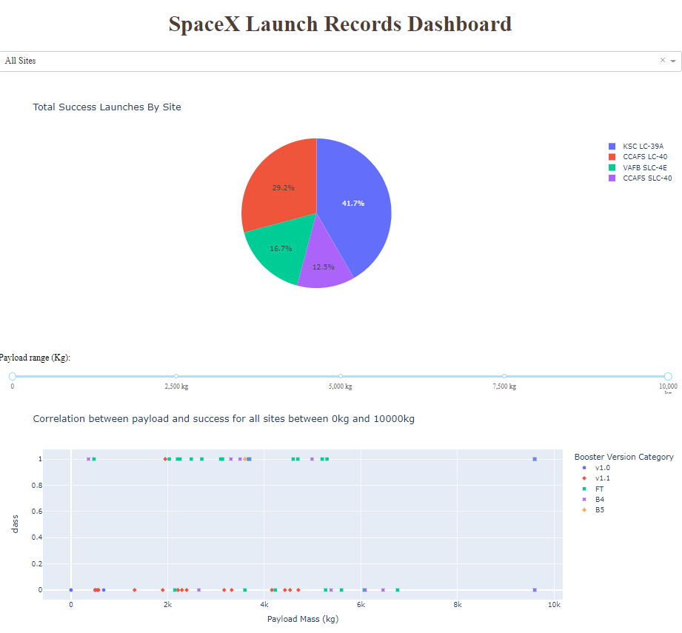
Results
Exploratory data analysis results
Interactive analytics demo in screenshots
Predictive analysis results

Slide 18


Slide 19
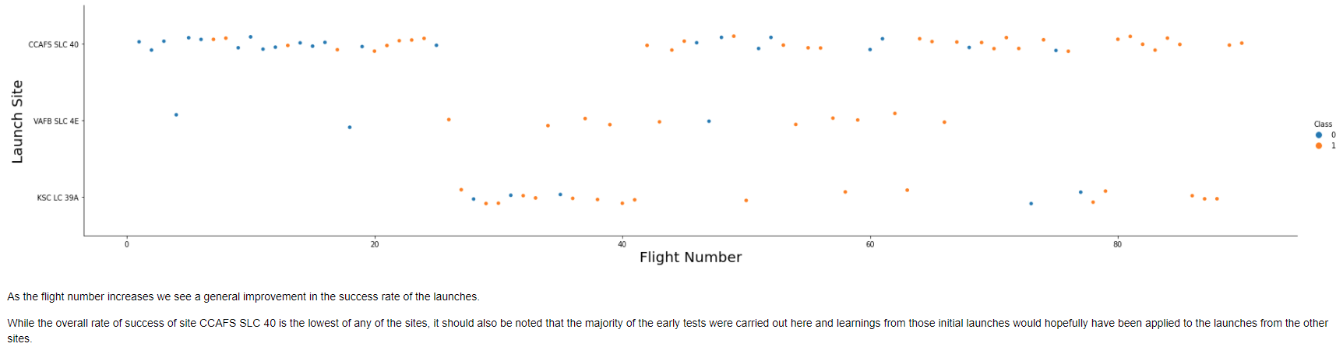
Flight Number vs. Launch Site

Slide 20
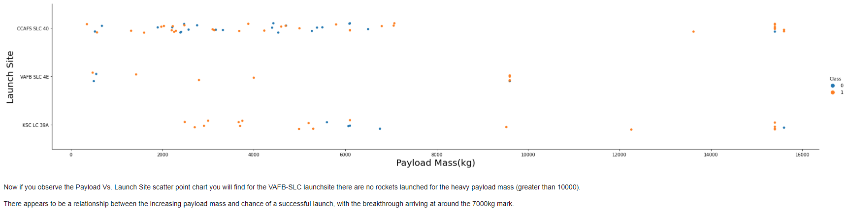
Payload vs. Launch Site

Slide 21
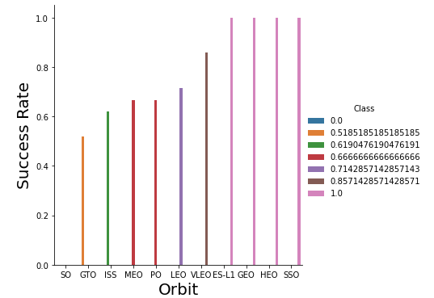
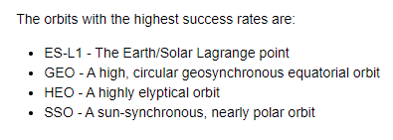
Success Rate vs. Orbit Type

Slide 22
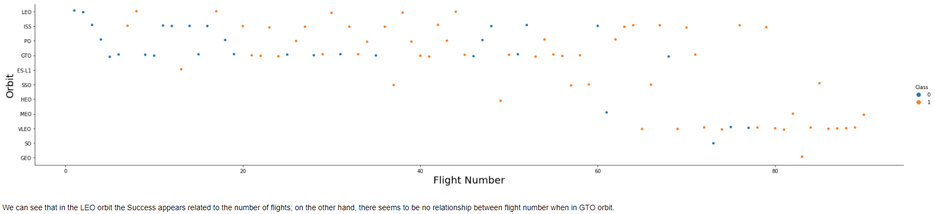
Flight Number vs. Orbit Type

Slide 23
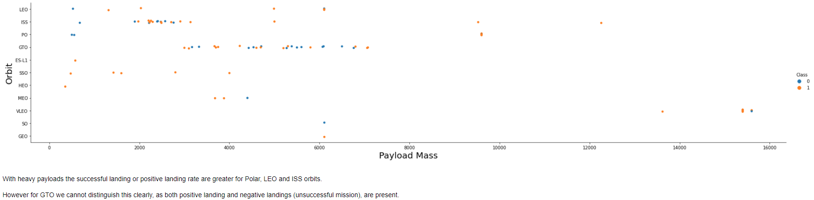
Payload vs. Orbit Type

Slide 24
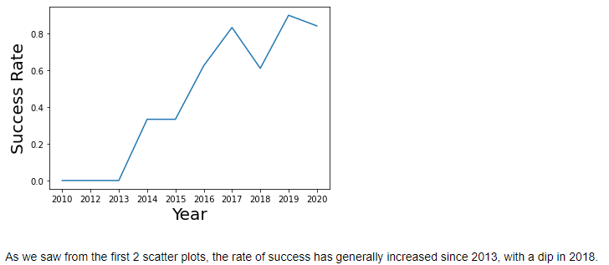
Launch Success Yearly Trend

Slide 25
Section 3
Insights drawn from SQL

Slide 26
All Launch Site Names
There are 4 unique launch sites:
CCAFS LC-40, CCAFS SLC-40, KSC LC-39A and VAFB SLC-4E
These were identified from the SpaceX DataSet using the following query: select distinct(launch_site) from SPACEXTBL
This query is using the distinct statement to return a list of unique values from the launch_site column of the SPACEXTBL table which contains the SpaceX DataSet data

Slide 27
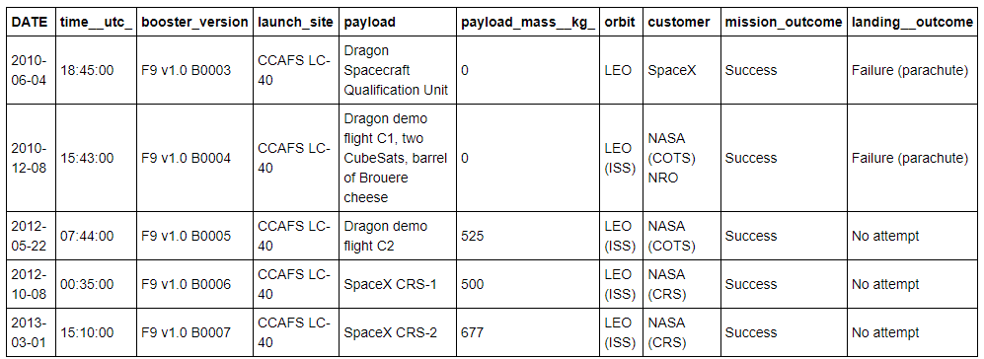
Launch Site Names Begin with 'CCA'
5 records where launch sites begin with `CCA`
select * from SPACEXTBL - select all records from the SpaceX DataSet where launch_site like 'CCA%’ - use the % wildcard after CCA to allow for different values LIMIT 5 - return only the first 5 results to meet the criteria

Slide 28
Total Payload Mass
The total payload carried by NASA (CRS) boosters was 45,596 kg
This was identified from the SpaceX DataSet using the following query: select sum(payload_mass__kg_) from SPACEXTBL where customer = 'NASA (CRS)'
This query is using the sum function to sum all values in the payload_mass_kg_ column of the SPACEXTBL table which was filtered on the customer with the name of NASA (CRS)

Slide 29
Average Payload Mass by F9 v1.1
The average payload mass carried by booster version F9 v1.1 was 2,928 kg
This was identified from the SpaceX DataSet using the following query:
select avg(payload_mass__kg_) from SPACEXTBL where booster_version like 'F9 v1.1'
This query uses the avg function to find the mean of all payload mass values which were filtered by the booster version matching F9 v1.1

Slide 30
First Successful Ground Landing Date
The first successful landing outcome on ground pad was December 22nd 2015
This was identified from the SpaceX DataSet using the following query:
select min(date) from SPACEXTBL where landing__outcome like 'Success (ground pad)'
This query uses the min function to select the first (smallest) date which was filtered by the landing outcome of 'Success (ground pad)'

Slide 31
Successful Drone Ship Landing with Payload between 4,000 and 6,000 kg
The following boosters have successfully landed on the drone ship and had a payload mass greater than 4,000 kg but less than 6,000 kg:
F9 FT B1022, F9 FT B1026, F9 FT B1021.2 and F9 FT B1031.2
These were identified from the SpaceX DataSet using the following query:
select distinct(booster_version) from SPACEXTBL where payload_mass__kg_ between 4000 and payload_mass__kg_ < 6000 and landing__outcome like 'Success (drone ship)'
This query uses the between keyword to select the payload mass range for the distinct 'Success (drone ship)' landing outcomes

Slide 32
Total Number of Successful and Failure Mission Outcomes
There was 1 failed mission outcome, 99 successful mission outcome, with 1 mission successful, but with an unclear payload status
This was identified from the SpaceX DataSet using the following query:
select count(mission_outcome),mission_outcome
from SPACEXTBL
group by mission_outcome
This query uses the count aggregation method and has been grouped by the mission outcome with the outcome included to aid display

Slide 33
Boosters Carried Maximum Payload
The following boosters have carried the maximum payload mass:
F9 B5 B1048.4, F9 B5 B1048.5, F9 B5 B1049.4, F9 B5 B1049.5, F9 B5 B1049.7, F9 B5 B1051.3, F9 B5 B1051.4, F9 B5 B1051.6, F9 B5 B1056.4, F9 B5 B1058.3, F9 B5 B1060.2, F9 B5 B1060.3
This was identified from the SpaceX DataSet using the following query:
select distinct(booster_version)
from SPACEXTBL
where payload_mass__kg_ =
(select max(payload_mass__kg_) from SPACEXTBL)
order by booster_version
This query uses a subquery to determine the maximum value of the payload mass, then uses that value to determine which boosters carried that mass

Slide 34
2015 Launch Records
The following are the failed landing_outcomes in drone ship, their booster versions, and launch site names for in year 2015:
These were identified from the SpaceX DataSet using the following query:
select date, landing__outcome, booster_version, launch_site
from SPACEXTBL
where year(date) = 2015
and landing__outcome like 'Failure (drone ship)'
This query uses the year function with the date field to return only those results from 2015
DATE | landing__outcome | booster_version | launch_site
2015-01-10 | Failure (drone ship) | F9 v1.1 B1012 | CCAFS LC-40
2015-04-14 | Failure (drone ship) | F9 v1.1 B1015 | CCAFS LC-40

Slide 35
Rank Landing Outcomes Between 2010-06-04 and 2017-03-20
The table below shows the frequency of the landing outcomes between June the 4th 2010 and March the 20th 2017 in descending order:
This was identified from the SpaceX DataSet using the following query:
select landing__outcome as "Landing Outcome", count(landing__outcome) as "Count" from SPACEXTBL where date between '2010-06-04' and '2017-03-20' group by landing__outcome order by 2 desc
This query again makes use of the between keyword to specify the date range; the grouping is by the landing outcome; and we rank the frequency referring to the aggregate column by number in the result set (2).
Landing Outcome | Count
No attempt | 10
Failure (drone ship) | 5
Success (drone ship) | 5
Controlled (ocean) | 3
Success (ground pad) | 3
Failure (parachute) | 2
Uncontrolled (ocean) | 2
Precluded (drone ship) | 1

Slide 36


Slide 37
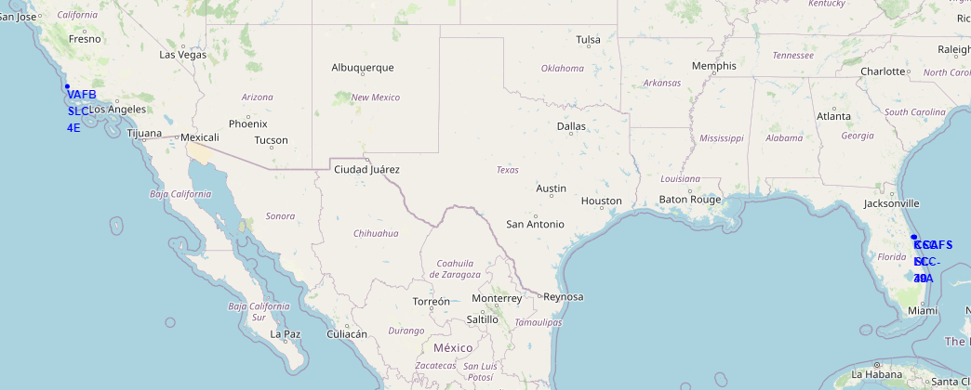
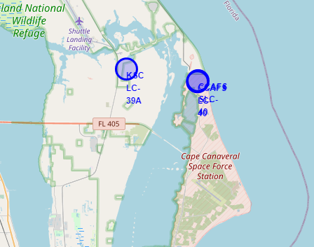
Launch Site Locations
The image above shows all launch site locations, with the image on the right expanded to show the eastern sites which are in close proximity to each other
Notice that all sites are practically on the coast and as close to the equator as possible

Slide 38
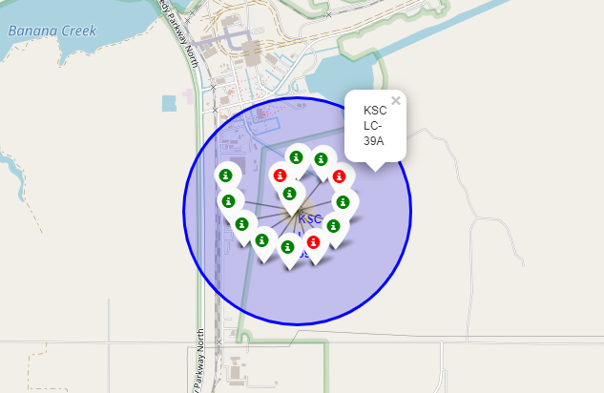
Successful Site Launches – KSC LC-39A
This image provides a graphical representation of the launch successes for site KSC LC-39A
Successful launches are marked in green, with failed launches marked in red

Slide 39
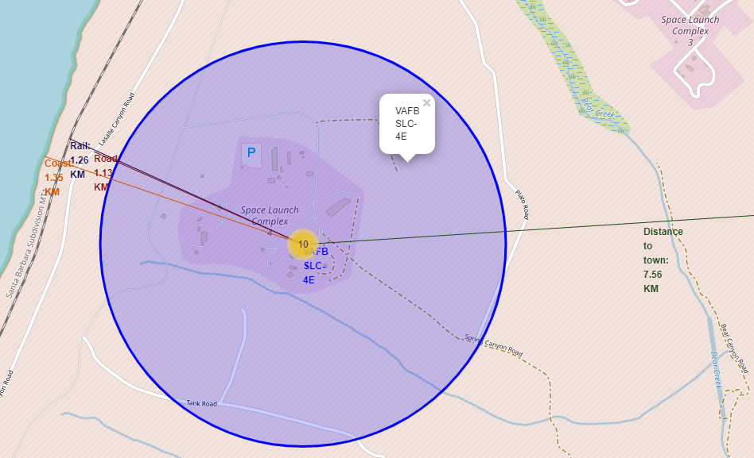
Distances to Items of Interest
This image gives distances to several close points of reference including the coast, a road and a railway line
The nearest town is far enough away that to include more than a reference to its location would render the other items illegible

Slide 40


Slide 41
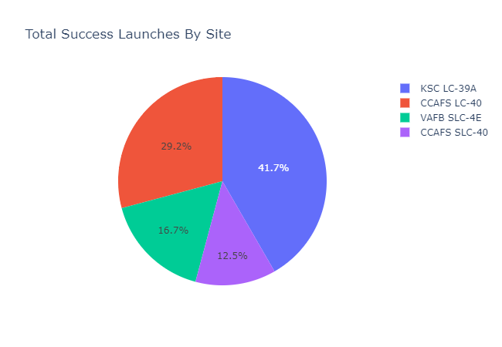
SpaceX Successful Launch % Per Site
The figure opposite shows the successful launches by site as a % of total launches made during the period
Three obvious limitations of this data are:
We do not know how many launches were made per site
The payload mass for each of the launches (determined later)
The date of each of the launches (later launches are typically more successful)

Slide 42
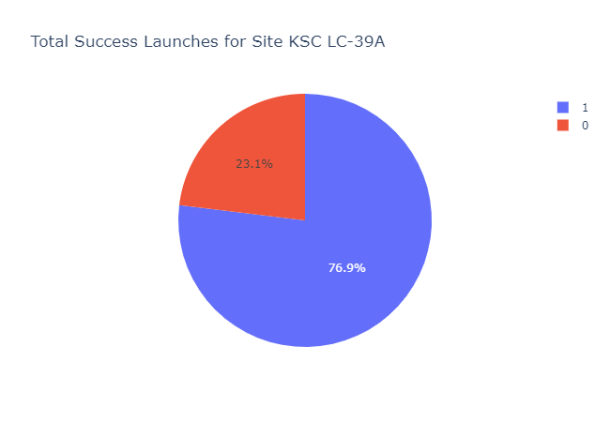
Successful Launch Ratio For Site KSC LC-39A
Of the 4 sites, KSC LC-39A had the highest individual successful launch rate with 76.9%
The figure opposite shows the breakdown by class with a 1 representing a successful launch

Slide 43
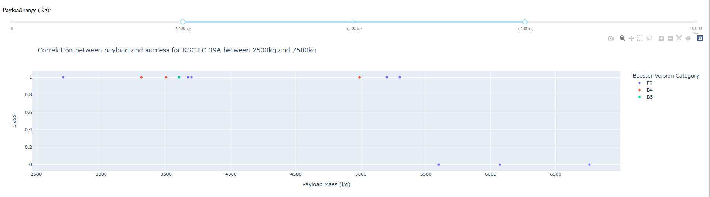
Analysis of Payload vs Success For Site KSC LC-39A
The figure above shows the correlation of the payload mass to the success for site KSC LC-39A which has been taken from an interactive scatter graph generated using Plotly Dash
As can be seen, the most successful payload mass for launches from the site during the period is between 2,500kg and 5,500kg

Slide 44


Slide 45
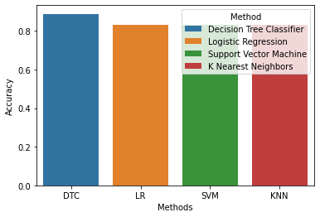
Classification Accuracy
It should be noted that we only have a small number of test samples which likely gives rise to the variability between runs
Where there is a most accurate model it is typically the Decision Tree Classifier that returned the highest accuracy, in this instance at 88.8889%

Slide 46
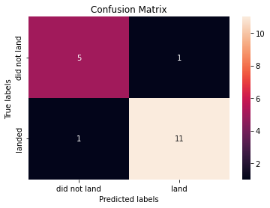
Confusion Matrix (DTC)
The correct predictions are on the diagonal from top-left to bottom-right
5 of the 6 failed landings were correctly identified along with 11 of the 12 successful landings
The other models all predicted a surplus of positive landings

Slide 47
Conclusions
Point 1
Point 2
Point 3
Point 4
…

Slide 48
Appendix
Include any relevant assets like Python code snippets, SQL queries, charts, Notebook outputs, or data sets that you may have created during this project

Slide 49


